Slide 1
HCI Evaluation
Part 2: Quantitative
Ruzanna Chitchyan, Jon Bird, Pete Bennett
TAs: Alex Elwood, Alex Cockrean, Casper Wang
Notes:
Simon

Slide 2
Today’s Workshop
Pair with another team to do quantitative evaluations of your game.
Each user will play your game at two different difficulty levels. After they have played the game at one of the difficulty levels ask them to fill in the NASA TLX and the SUS; then get them to play the game at the other difficulty level and after they have played it ask them to fill in the NASA TLX and the SUS again. Calculate the aggregate NASA TLX and SUS scores for each game level (you will calculate 4 scores).
Overall, you are aiming to get at least 10 users to evaluate your game and the workshop is an opportunity to start collecting data.
Once you have enough data use the online calculator to see if the Wilcoxon signed rank test shows a significant difference between the workload and usability scores at different difficulty levels.
Homework: complete the evaluations with at least 10 users. Write these up and add them to your repo.
Notes:
与另一个团队配对，对你的比赛进行定量评估。
每个用户将以两个不同的难度级别玩游戏。在他们玩完其中一个难度级别的游戏后，请他们填写NASA TLX和SUS；然后让他们玩另一个难度级别的游戏，在他们玩完之后，请他们再次填写NASA TLX和SUS。计算每个游戏级别的NASA TLX和SUS总分（您将计算4分）。
Overall, you are aiming to get at least 10 users to evaluate your game and the workshop is an opportunity to start collecting data.
Once you have enough data use the online calculator to see if the Wilcoxon signed rank test shows a significant difference between the workload and usability scores at different difficulty levels.
Homework: complete the evaluations with at least 10 users. Write these up and add them to your repo.

Slide 3
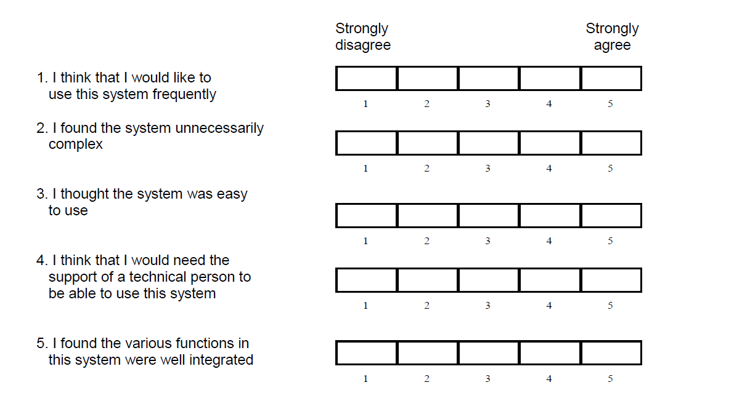
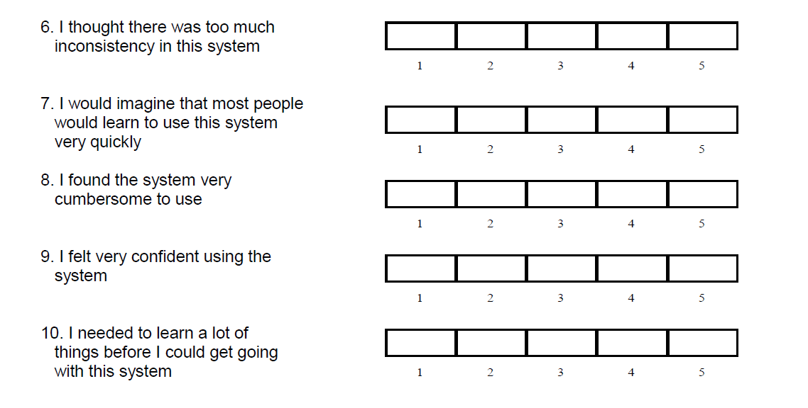
System Usability Scale

Slide 4
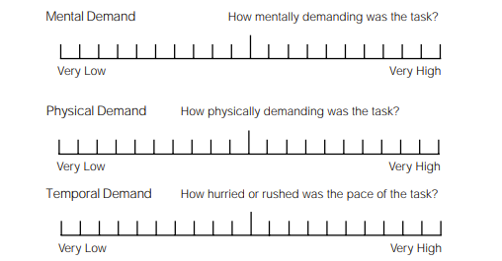
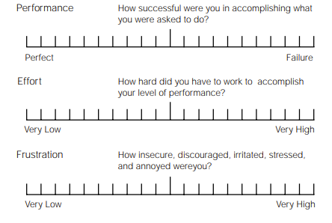
NASA TLX

Slide 5


Homework / Groupwork
Complete the evaluations with at least 10 users.
Write up the findings of the quantitative user evaluations and add this to your repo.
Now your game is underway, reconsider your games three challenges and make sure these are added to your repo (note, these are technical challenges, and not development/team challenges)
Notes:
与至少10名用户一起完成评估。
写下定量用户评估的结果，并将其添加到您的回购中。
现在你的游戏正在进行中，重新考虑你的游戏三个挑战，并确保将它们添加到你的回购中（注意，这些是技术挑战，而不是开发/团队挑战）

